Slide 1

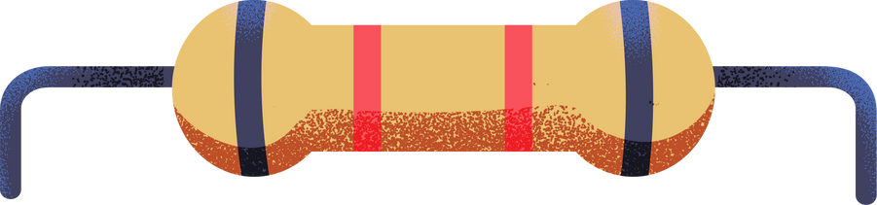
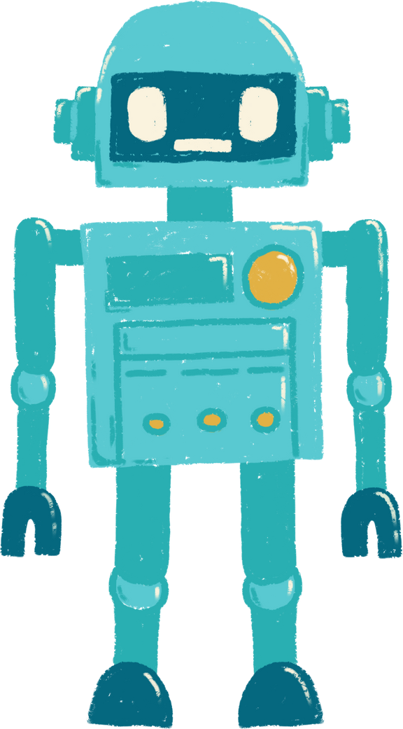


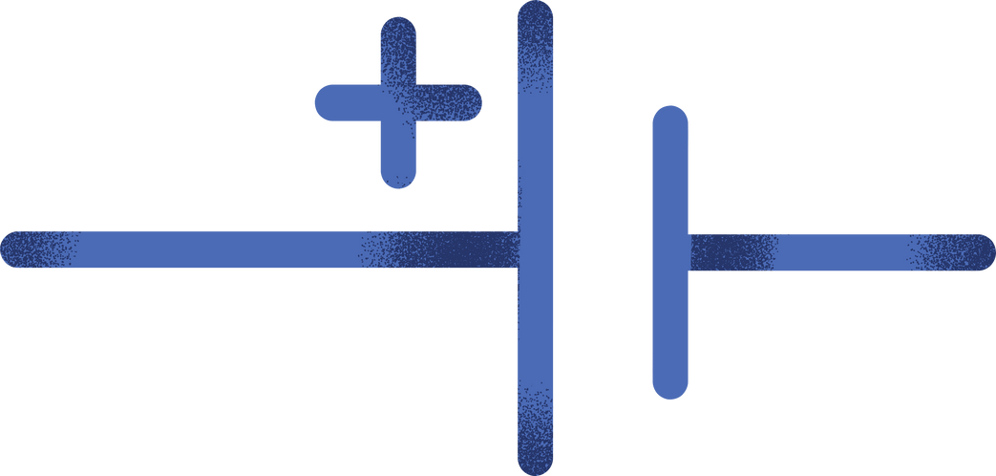
AI Tools
in the
Writing Field
Ysabella De Leon

Slide 2
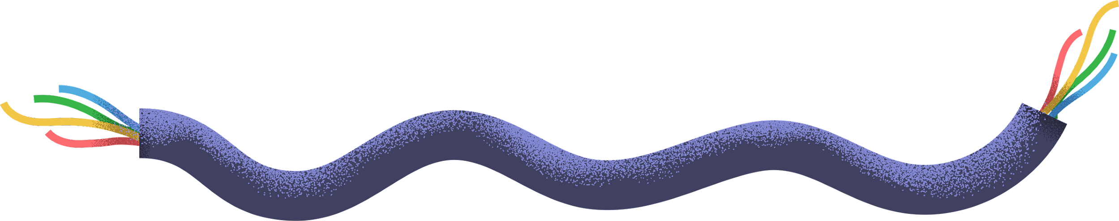

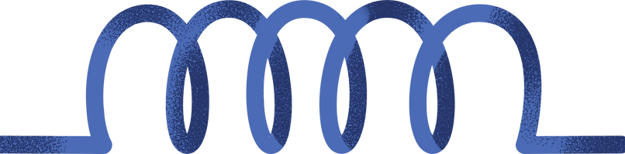
One of the first AI writing tools to become popular
Created by OpenAI
Proved itself to be very fluent and creative in creating conversations
Showcases its limitations in long form written content
This Photo by Unknown Author is licensed under CC BY-SA

Slide 3




More AI writing tools include
Essayservice.ai
Service that connects writers with professional writers for help
Myessaywriter.ai
Provides help through every step of the writing process
PerfectEssayWriter.ai
Combines the features of the two previous tools, plus much more

Slide 4
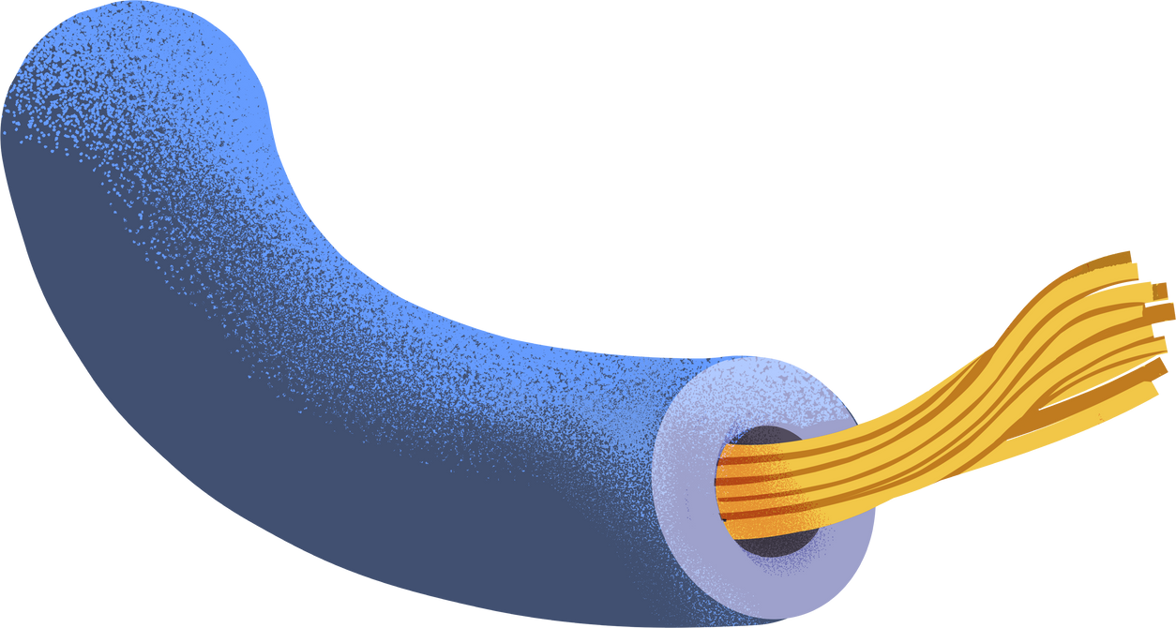
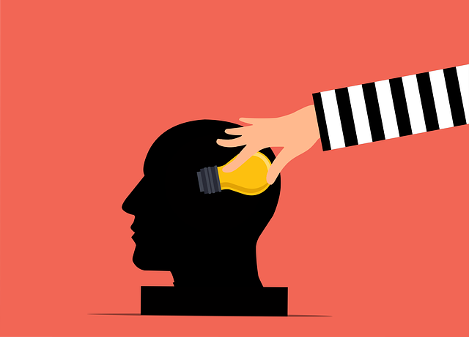

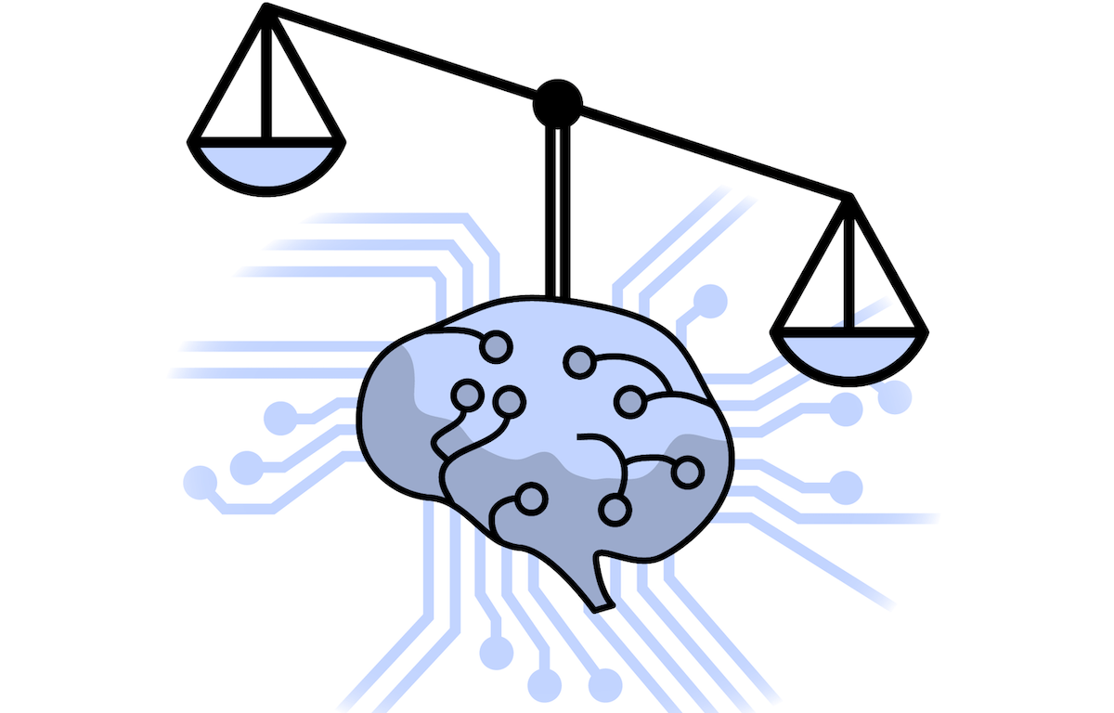

Ethical Concerns of the Use of AI Writing Tools
Plagiarism
Bias
Equity
Job Loss

Slide 5
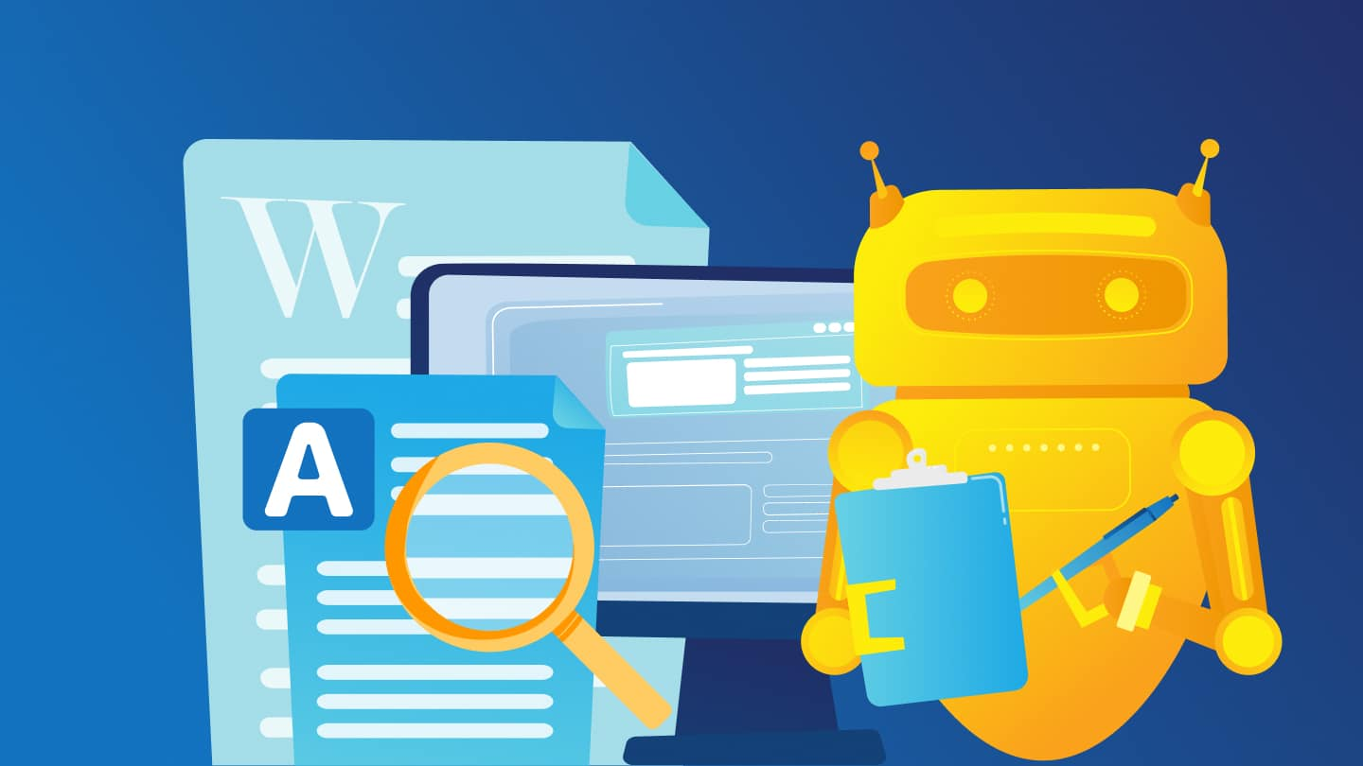
Plagiarism
AI generated content is not original
AI tools generate writing that is a mix of writing from different sources and people across the internet
No legal framework has been developed against AI writing yet

Slide 6
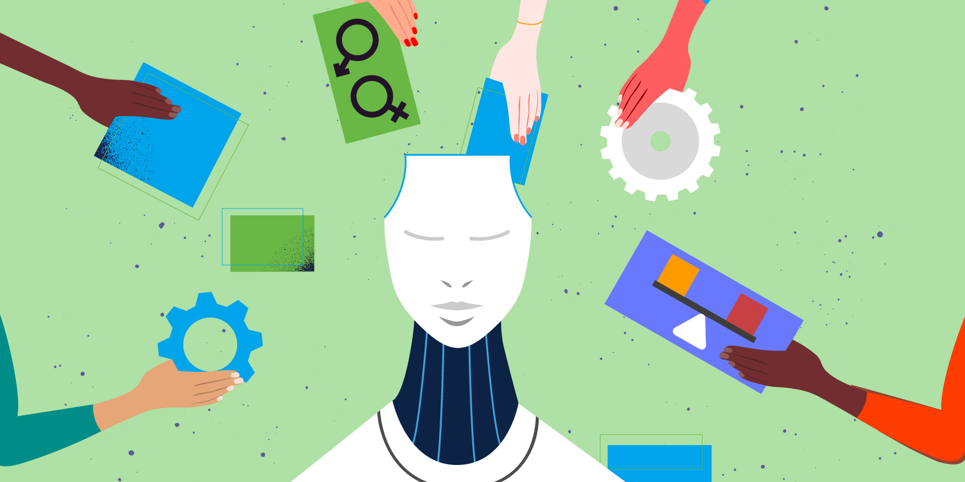
Bias
AI has no ideology
Some AI generated content can contain opinions and bias from other people’s writing
This results in writing that contains discrimination or could perpetuate stereotypes

Slide 7
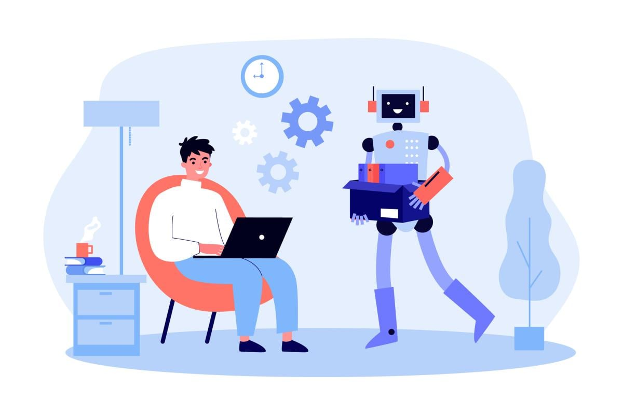
Equity
Since AI is so accessible, anyone can use it, even students
While this technology could be helpful to students, this would lead to work that is not original
Would end up being more of detriment to a student’s learning, rather than helping them

Slide 8

Job Loss
With how fast and efficient AI is, it’s possible for companies to start using it
This could possibly result in writers being replaced by AI

Slide 9
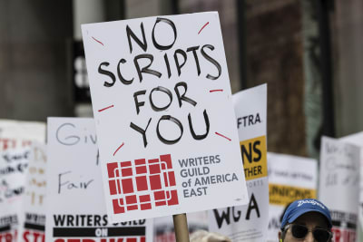
Writers Strike (May 23 – Sept 27, 2023)
One of the longest labor strikes in Hollywood
One of the main reasons for the strike was for safeguards for their jobs from the use of AI content tools
In the end the WGA (Writer’s Guild of America) was able to win a new deal with safeguards in place against AI

Slide 10

New Deal Key Points
AI may not rewrite material
AI generated work will not be used to undermine the work of real writer’s

Slide 11
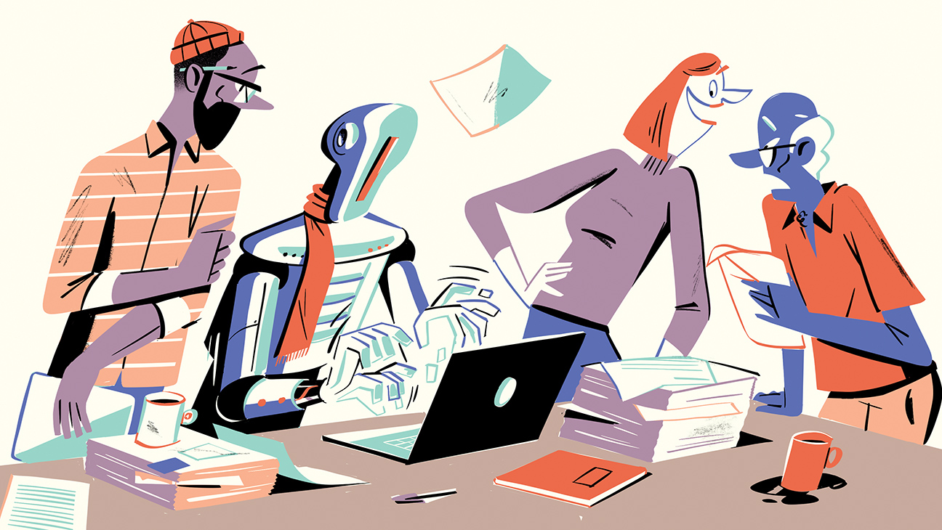
New Deal Key Points
The writer’s have the choice of using AI, not the employer
This keeps AI under control of the writer’s and not the studios

Slide 12
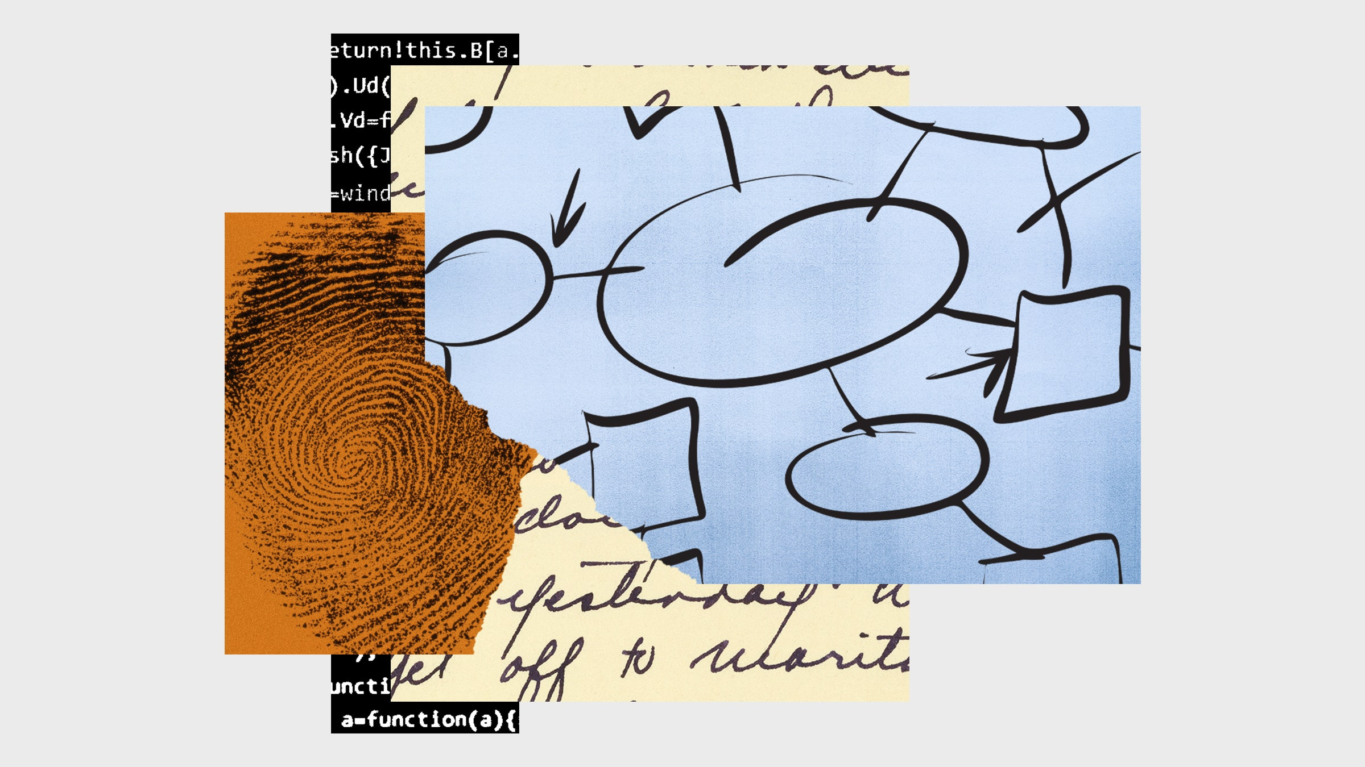
New Deal Key Points
Companies must disclose if any material given to writer’s is AI generated

Slide 13
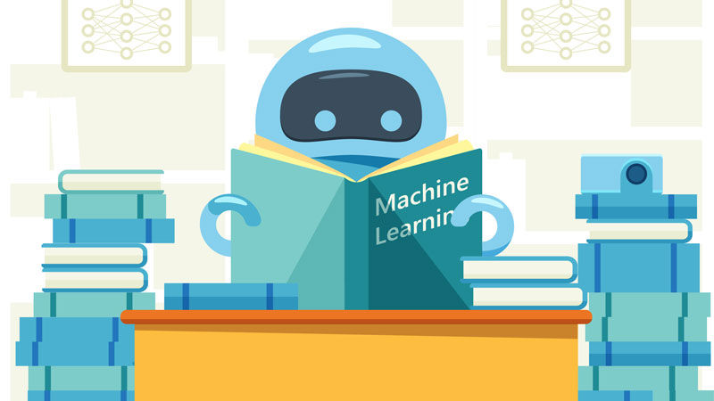
New Deal Key Points
A writer’s work cannot be used to train AI writing tools

Slide 14
Works Cited
Adzo, Kokou. The Evolution of AI in Writing: Examining the Journey from ChatGPT to Specialized Tools like PerfectEssayWriter.ai. 20 May 2023, startup.info/the-evolution-of-ai-in-writing-examining-the-journey-from-chatgpt-to-specialized-tools-like-perfectessaywriter-ai/.
Anguiano, Dani, and Beckett, Lois. “How Hollywood Writers Triumphed over AI – and Why It Matters.” The Guardian, 1 Oct. 2023, www.theguardian.com/culture/2023/oct/01/hollywood-writers-strike-artificial-intelligence.
Curriculum, Writing Across the. “Ethical Issues in AI - Carleton College.” Www.carleton.edu, www.carleton.edu/writing/working-with-ai/ethical-issues/.
“The Ethics of Using AI Content Tools in Writing.” AIContentfy, 26 May 2023, aicontentfy.com/en/blog/ethics-of-using-ai-content-tools-in-writing
Schwob, Landon R., and Lyon, Todd A. “Agreement on Key AI Terms Leads to Writer’s Strike Resolution: What Employers Need to Know.” Fisher Phillips, www.fisherphillips.com/en/news-insights/agreement-on-key-ai-terms-leads-to-writers-strike-resolution-what-employers-need-to-know.html#:~:text=AI%20may%20not%20write%20or.
Smith, James. “The Evolution of Writing: AI Tools at the Forefront.” Medium, 7 Aug. 2023, medium.com/@James-Writer/the-evolution-of-writing-ai-tools-at-the-forefront-2d003e946263.

